Slide 1
Intoducking teh Footue of Trainspot

Slide 2
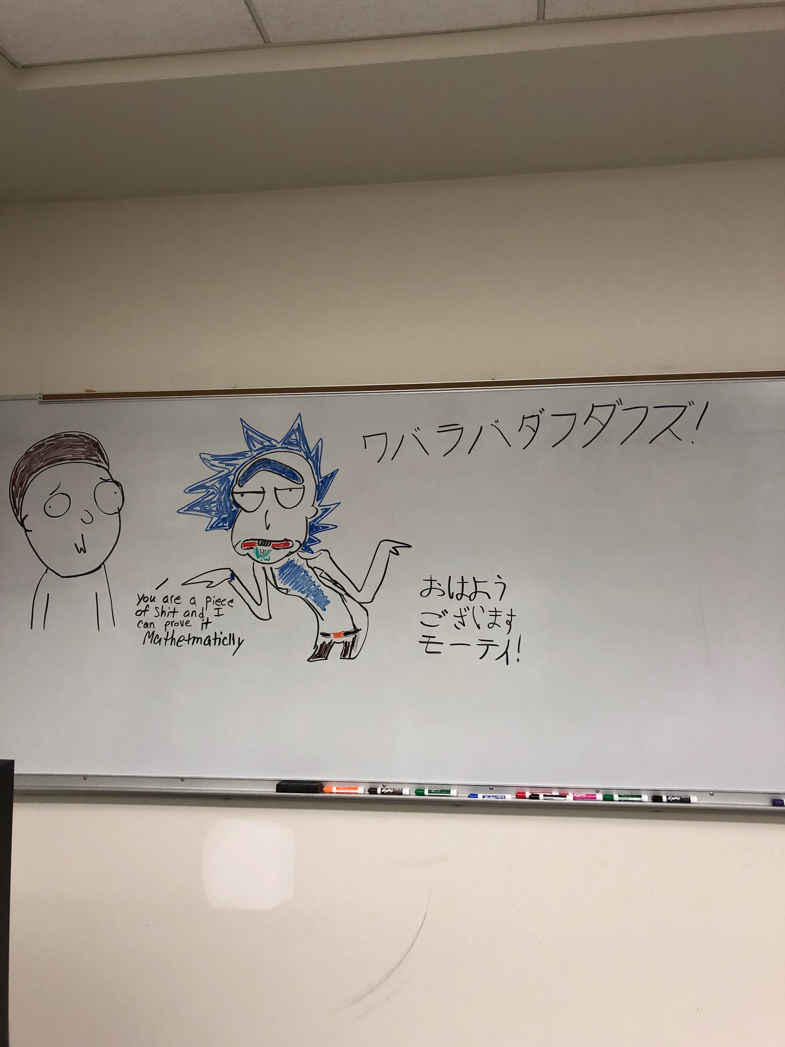
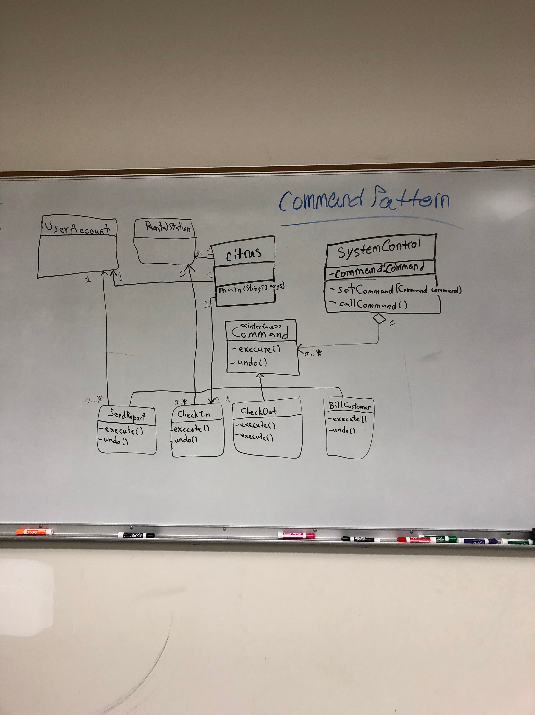
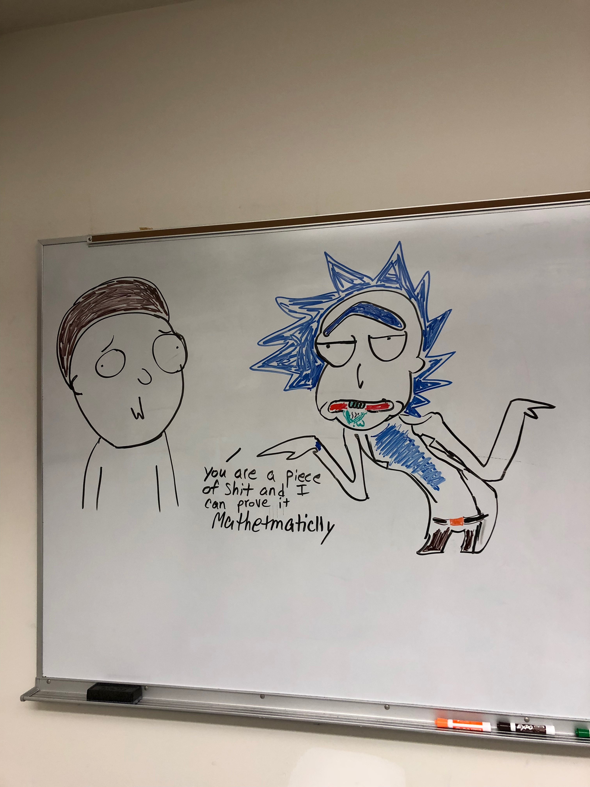
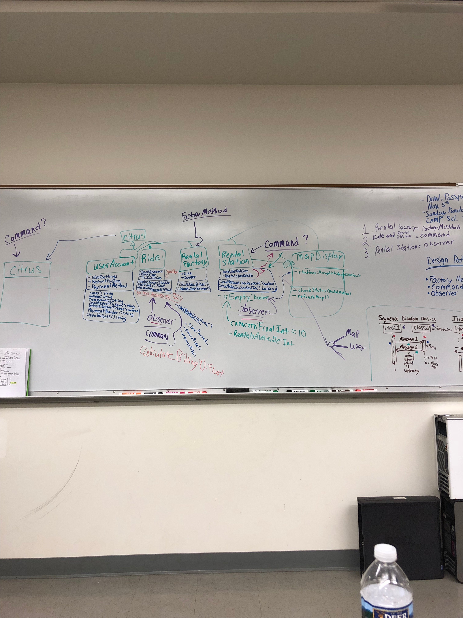
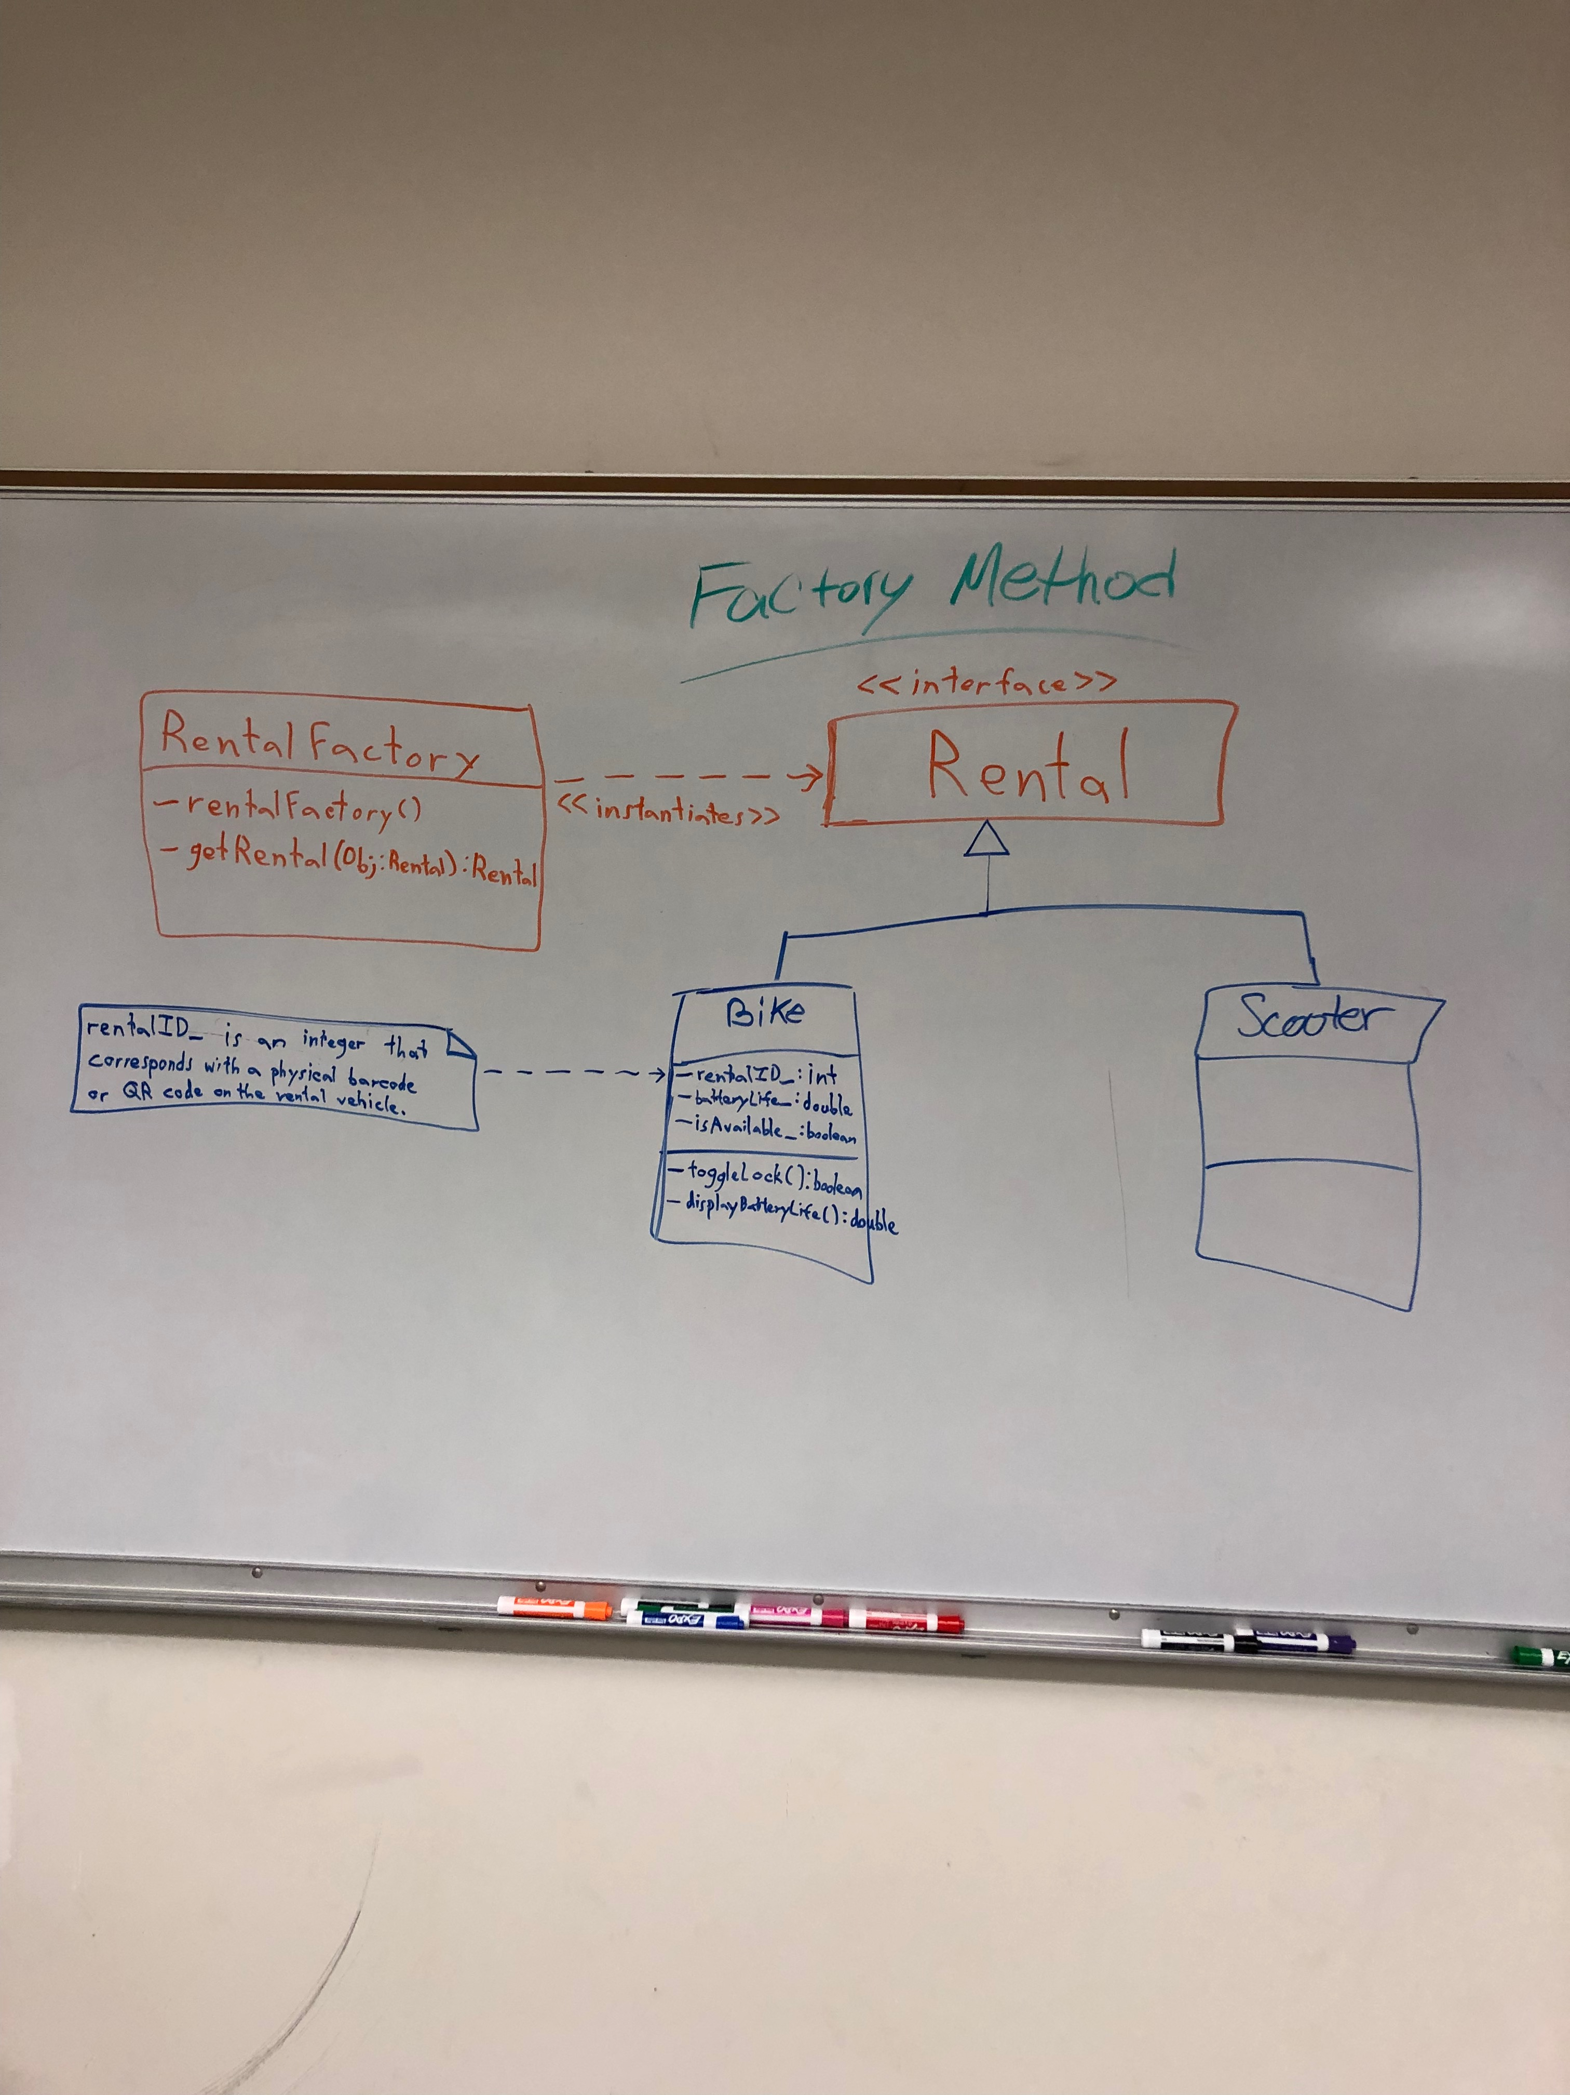
What Do, Refreash?

Slide 3

Coding the App
Christian
Everyone else

Slide 4
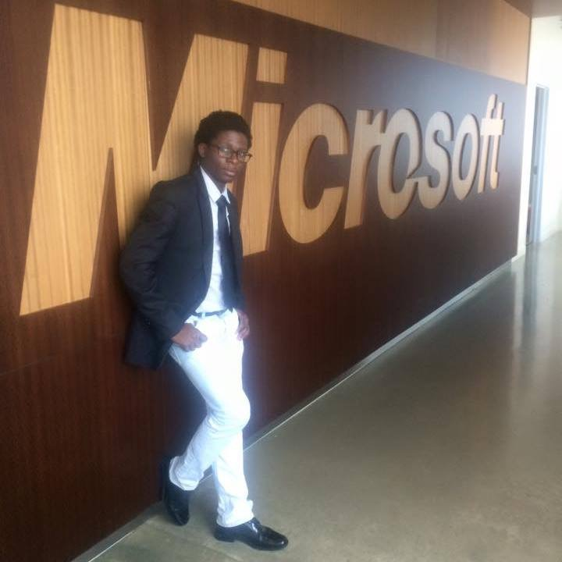

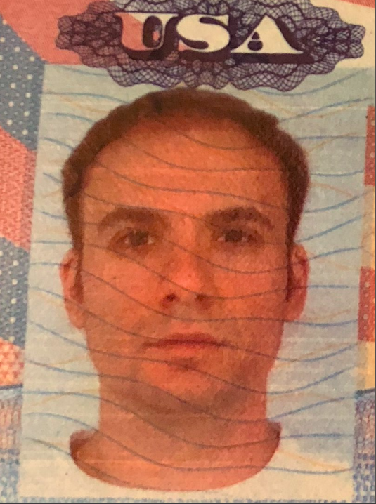
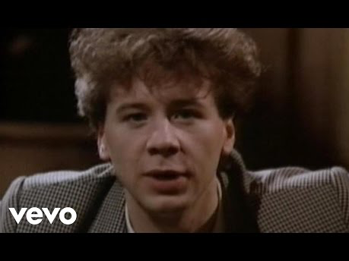
Where are they now…
Christian later went on to create a direct competitor to Microsoft called Macrohard. He now uses the image above to mock them.
He’s just alright
Michael later went on to get arrested for saying not so nice things…. and being involved in an illegal cryptocurreny ponzi scheme. He now lives the rest of his days in a maximum security prison in Mexico.

